Slide 1

Credit Card fraud detection using machine learning
Group ID – 12
Ritik Shah – 1814050
Anuj Sarda – 1814052
Dhairya Shah – 1814053

Slide 2

Problem Definition
A credit card remains a very widespread compensation method that is accepted online & offline, and provides cashless transactions.
With the increase of developments credit card frauds are also growing.
Billion dollars are at loss due to these fraudulent acts.
In directive to minimalize disorder and bring order in place, having a well-organized method of fraud detection has become a need for all banks.
A machine learning based technique is proposed in this direction to detect the credit card frauds.

Slide 3

introduction
3 types of Frauds – Financial, Communication, Online Marketing. Credit card fraud was included in financial fraud.
The areas where Machine Learning is used – Classification, Regression, Clustering etc.
Algorithms such as Random Forest, Isolation Forest, SVM, LOF, KNN, Naive Bayes, Genetic algorithms etc. are used to increase the chances of accuracy.
Performance comparison of the above mentioned algorithms to analyse the best technique in terms of Accuracy, Precision, Recall, F1 Score.

Slide 4
Detection techniques
DECISION TREE - Decision Tree is a non-parametric supervised machine learning method. It has a specified target variable that is commonly utilised in the categorization of problems.
LOCAL OUTLIER FACTOR - The Local Outlier Factor (LOF) rule is an unattended anomaly detection approach that computes a given information's native density deviation in relation to its neighbours. It considers samples that have a significantly lower density than their neighbours, to be outliers.
ISOLATION FOREST - Each point in the data is isolated and classified as an outlier or an inlier by the algorithm. This method has the benefit of working with a large data collection and several dimensions

Slide 5
SUPPORT VECTOR MACHINE - Support Vector Machine (SVM) is a classification algorithm rule, just like logistic regression. Support vector machine is a supervised learning model with association learning algorithm, which can analyse information for classification and multivariate analysis.
K-NEAREST NEIGHBOUR - The K-nearest neighbour algorithm is a classification algorithm, which predicts the attributes of other points based on the relative position of an information point. Its classification is based on similarity measures, such as the Euclidean distance and the Manhattan distance measure.
NAÏVE BAYES - Naïve Bayes classifier is based on Bayes' theorem, which chooses the decision based on the highest probability.

Slide 6
Confusion matrix
Confusion Matrix: The confusion matrix provides information from correctly misclassified classes, and we can use this information to identify errors, thereby gaining a deeper understanding of the performance of our model.
TP – True Positives
FP – False Positives
TN – True Negatives
FN – False Negatives

Slide 7
Random Forest (RF)
Most commonly utilised in areas like classification and regression analysis.
The RF method generates a large number of decision trees during training.
RF is a supervised learning method that requires test data to train the model.
It produces random forests for the issue set and then uses these random forests to discover the answer.

Slide 8
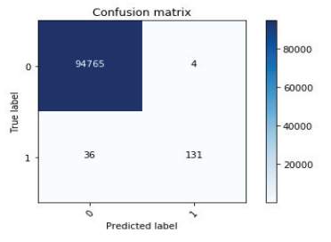
RF Performance
The confusion matrix of the prediction results produced using the Random Forest machine learning method is shown in the figure.
The Random Forest algorithm accurately predicts zeroes in the final output 94765 times while erroneously predicting zeros 4 times.
The Random Forest algorithm accurately
predicted one's identity 131 times and
erroneously predicted one's identity
36 times.

Slide 9
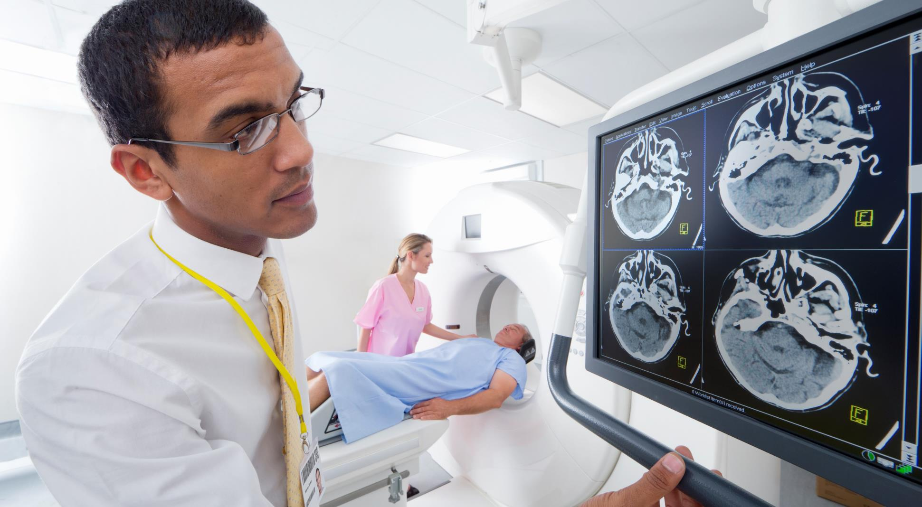




Performance Measures
Accuracy
Precision
Recall
F1 Score
Accuracy is the percentage of correctly predicted outputs
Accuracy = (TP + TN) / (TP + FP + TN + FN)
number of classified correct outputs we can say exactness of model.
Precision = TP
/ (TP + FP)
The measure of our model correctly identifying True Positives
Recall = TP
/ (TP + FN)
F1 Score is the average of Precision and Recall.
F1 Score = 2 * (Precision * Recall) / (Precision + Recall)

Slide 10
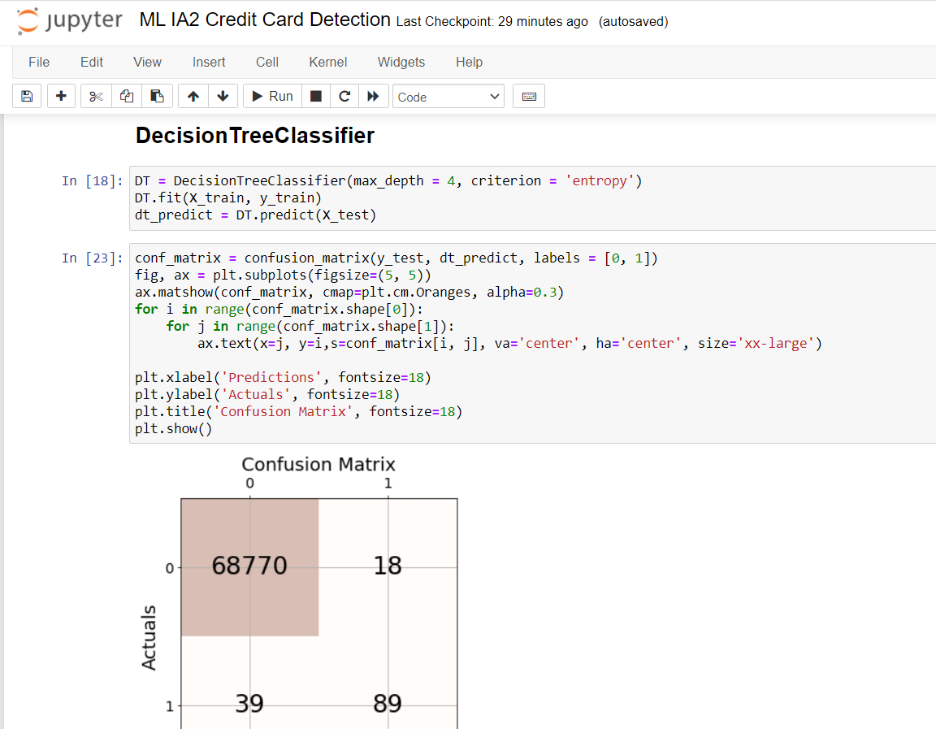
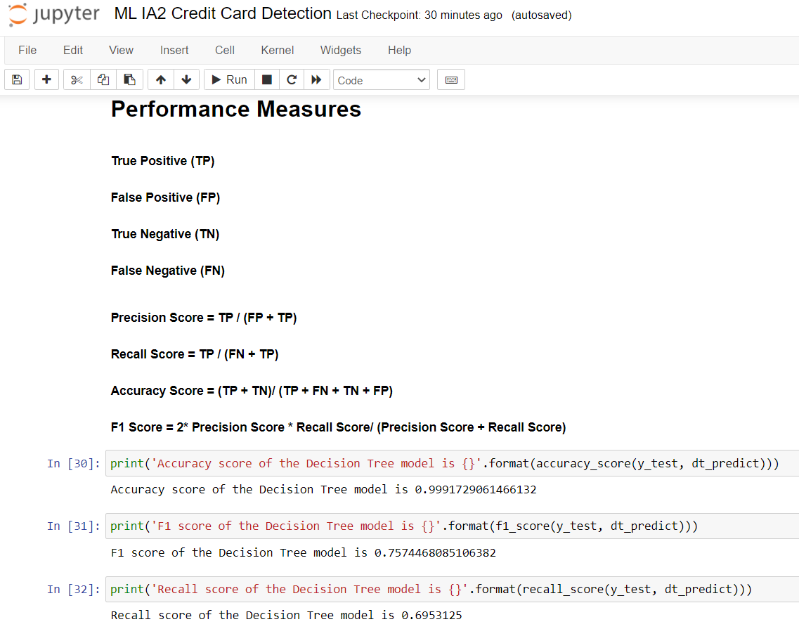
CODE SNIPPETS

Slide 11
RESULTS
99.91%
99.89%
97.77%
Random Forest
Logistic Regression
Naïve Bayes
99.93%
99.91%
99.92%
Support Vector Machine
Decision Tree
K-Nearest Neighbour

Slide 12

conclusion
The six algorithms are tested on the basis of their prediction accuracy and confusion matrix. These parameters are used for comparison of performance.
A support vector matrix is better than any other technique as it provides an accuracy of 99.93%.
All algorithms work almost the same, with small differences, but we can consider that if these algorithms are trained with more data from the real world, the efficiency and prediction will be improved.

Slide 13
References
D. Tanouz, R. R. Subramanian, D. Eswar, G. V. P. Reddy, A. R. Kumar and C. V. N. M. Praneeth, "Credit Card Fraud Detection Using Machine Learning," 2021 5th International Conference on Intelligent Computing and Control Systems (ICICCS), 2021.
P. Roy, P. Rao, J. Gajre, K. Katake, A. Jagtap and Y. Gajmal, "Comprehensive Analysis for Fraud Detection of Credit Card through Machine Learning," 2021 International Conference on Emerging Smart Computing and Informatics (ESCI), 2021.
V. Jain, M. Agrawal and A. Kumar, "Performance Analysis of Machine Learning Algorithms in Credit Cards Fraud Detection," 2020 8th International Conference on Reliability, Infocom Technologies and Optimization (Trends and Future Directions) (ICRITO), 2020.
K. Rai and R. K. Dwivedi, "Fraud Detection in Credit Card Data using Unsupervised Machine Learning Based Scheme," 2020 International Conference on Electronics and Sustainable Communication Systems (ICESC), 2020.
O. Adepoju, J. Wosowei, S. lawte and H. Jaiman, "Comparative Evaluation of Credit Card Fraud Detection Using Machine Learning Techniques," 2019 Global Conference for Advancement in Technology (GCAT), 2019.
P. Kumar and F. Iqbal, "Credit Card Fraud Identification Using Machine Learning Approaches," 2019 1st International Conference on Innovations in Information and Communication Technology (ICIICT), 2019.

Slide 14

Thank you

